Slide 1

Two Stage Job Title Identification System for Online Job Advertisements
by
B GunaTeja
Roll No. 224G5A3204
K Deekshitha
Roll No. 214G1A3215
M Harshitha
Roll No. 214G1A3222
K Lahari
Roll No. 214G1A3244
Under the guidance of
Mr. Nazeer shaik _{M. Tech.(P.hd).}
Assistant Professor
Department of Computer Science and Engineering (Data Science)
Srinivasa Ramanujan Institute of Technology
(Affiliated to JNTUA & Approved by AICTE) (Accredited by NAAC with ‘A’ Grade & Accredited by NBA (EEE, ECE & CSE)
Rotarypuram Village, B K Samudram Mandal, Ananthapuramu – 515701.
2024 - 2025

Slide 2
Abstract
Data science techniques are vital for analyzing job markets through online job advertisements, but existing methods often require extensive labeled datasets and focus on databases like O*NET, limiting their scope. This study proposes a two-stage job title identification system for smaller datasets, applied to the Moroccan job market. The first stage uses Bidirectional Encoder Representations from Transformers (BERT) to classify ads by sector, while the second employs unsupervised learning and similarity measures to identify job titles. A novel document embedding strategy enhances accuracy. Results show a 14% improvement, with accuracy exceeding 85% in some sectors, outperforming state-of-the-art methods.

Slide 3

Contents
Abstract
Introduction
Literature survey
Proposed Work
References
GitHub Link
Queries

Slide 4
Introduction
The widespread use of the Internet and digitization of processes, driven by social media, has generated a vast amount of data across industries.
Emphasizing the importance of efficient data processing for informed decision-making in a rapidly evolving digital world.
Highlights data science as a potent tool for extracting insights from diverse datasets and simplifying traditional processes.
Recognizes the job market's shift from traditional to online channels, presenting an opportunity for understanding market needs from the vast daily data.
Aims to benefit labor market analysts, policymakers, job seekers, students, and recruiters by providing valuable insights and guidance.

Slide 5
Literature Survey
No | Title | Author | Journal Name & Year | Methodology Adapted | Key Findings | Gaps
1 | Two-Stage Job Title Identification for Online Job Ads | I. Rahhal et al. | IEEE Access, 2023 | Supervised learning (BERT, SVM) for sector classification; unsupervised algorithms for title matching | Improved accuracy by 14%; Document embedding enhanced classification accuracy by 23.5% | Limited labeled data; region-specific focus (Morocco)
2 | Predicting Job Titles from Job Descriptions with Multi-label Text Classification | H. T. Tran, H. H. P. Vo, and S. T. Luu | Springer AI Journal, 2022 | Pre-trained models (e.g., BERT, GPT-2) | Multilingual models showed highest accuracy; combining job title and description improves performance | High computational cost
3 | Multi-Stage Classifier for Job Title Normalization | Mayukh Maitra,Surabhi Sinha, Tomas | IEEE Access, 2020 | Manual taxonomy, string similarity measures | Multi-stage classification handled large class hierarchies effectively | Reliance on crowd-sourced training data

Slide 6
Contd....
No | Title | Author | Journal Name & Year | Methodology Adapted | Key Findings | Gaps
4 | Automated Job Matching Using Similarity and Clustering | Maitri Dipak Amin, Aishwarya Chandrashekhar, Nitya singh | Elsevier, 2019 | Clustering and similarity-based approaches | Addressed noisy datasets with preprocessing strategies | Limited scalability for dynamic trends
5 | Occupation Identification in Low-Resource Settings | Lina Cao, Jian Zhang, Jindong Chen | ACM Digital Library, 2021 | Self-supervised learning and document embedding | Achieved high accuracy despite small datasets; applied methodology to emerging occupations in Morocco | Focused on a limited regional dataset

Slide 7
Proposed System
The proposed system introduces a two-stage job title identification methodology. In the first stage, it uses BERT to classify job ads into sectors. In the second stage, unsupervised machine learning algorithms and similarity measures are employed to identify the most suitable job title from the predicted sector.
The system is further enhanced with a document embedding strategy that transforms job ads into numerical representations, improving classification accuracy by reducing noise and handling contextual ambiguities. This two-stage approach not only improves accuracy, especially with smaller datasets, but also offers a scalable, adaptable solution for job market analysis, helping job seekers, recruiters, and policymakers make more informed decisions.

Slide 8
Contd....
ADVANTAGES
The system minimizes the need for extensive labeled datasets, enhancing adaptability and cost-efficiency.
It is designed to work across various job markets and linguistic contexts, in contrast to region-specific systems.
The two-stage methodology, including BERT and unsupervised learning, leads to significant accuracy enhancements, particularly within specific sectors.
The system's flexibility and document embedding strategies make it easier to adapt to changing job markets and incorporate new titles or sectors, reducing rigidity.

Slide 9
Reference
[1]. I. Rahhal, K. M. Carley, I. Kassou, M. Ghogho, “Two-Stage Job Title Identification for Online Job Ads,” IEEE Transactions on Knowledge and Data Engineering, vol. 100, pp. 45-60, Feb. 2023.
[2]. H. T. Tran, H. H. P. Vo, and S. T. Luu, ‘‘Predicting job titles from job descriptions with multi-label text classification,’’ in Proc. 8th NAFOSTED Conf. Inf. Comput. Sci. (NICS), Dec. 2021, pp. 513–518.
[3]. Mayukh Maitra, Surabhi Sinha, Tomas, “Multi-Stage Classifier for Job Title Normalization” IEEE Transactions on Knowledge and Data Engineering, pp. 1-6, Jan 2020.
[4]. Maitri Dipak Amin, Aishwarya Chandrashekhar, Nitya singh, “Automated Job Matching Using Similarity and Clustering”, in Elsevier, pp. 1-6, Mar 2019.

Slide 10
Contd....
[5]. Lina Cao, Jian Zhang, Jindong Chen, “Occupation Identification in Low-Resource Settings”, in ACM Digital Library, vol. 155, pp. 14-17.

Slide 11
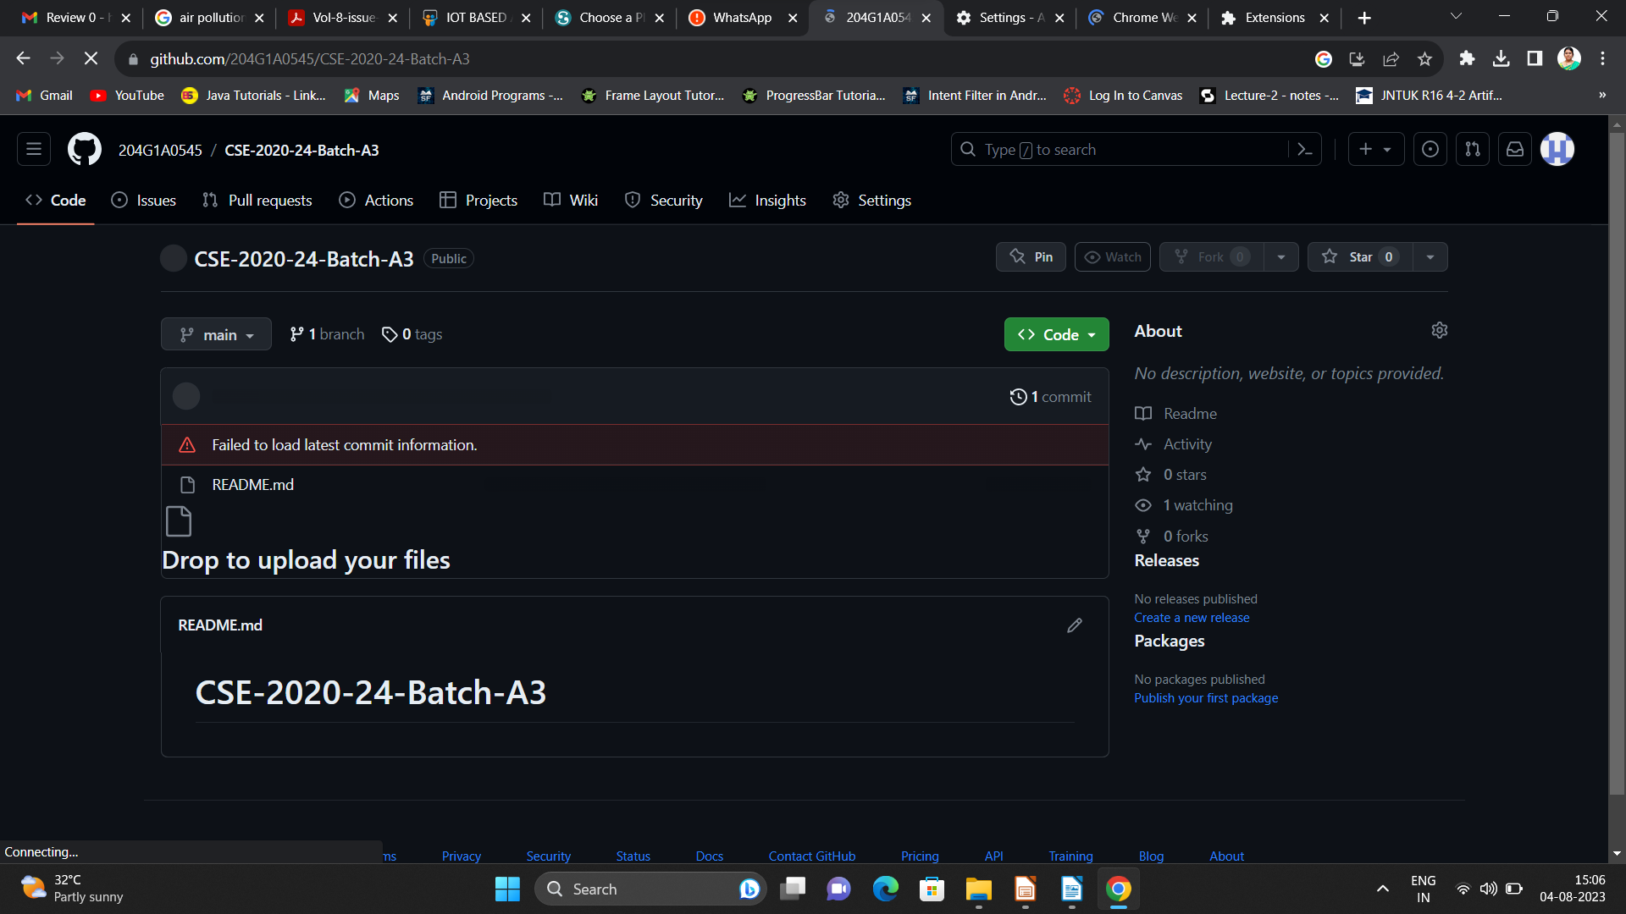

Git Hub Dashboards of each student
Repository Name Like: CSD 2024 – 25 Batch: A – XX
Under that project data upload literature survey papers, and son on..

Slide 12
Any Queries?

Slide 13
Thank You!!!

